Slide 1
Plasma and Dust Tracing through the Europa-Jupiter
Magnetic Interaction Region
APL Europa ICONS Meeting
Andrew Cates
7/31/25

Slide 2
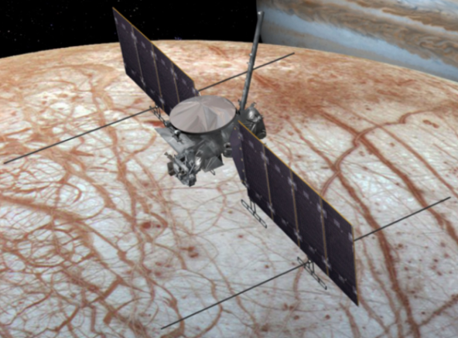
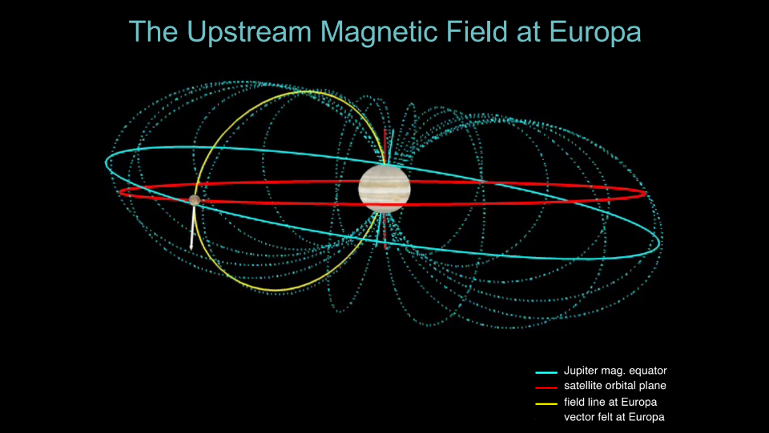
The Europa Clipper Mission
7/31/25
Courtesy of NASA/JPL-Caltech
Electromagnetic environment of Europa shape charged particle and dust behaviors
Jupiter’s strong magnetic field, Europa’s own induced magnetic field, and ionized material all contribute to system
Courtesy of NASA/GSFC

Slide 3
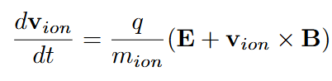
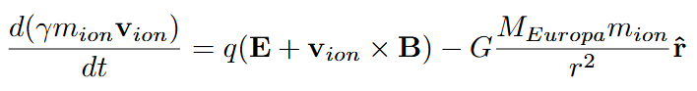
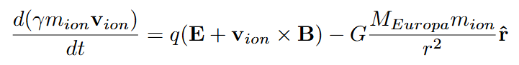
Physical/Mathematical Background
7/31/25
Classical
Solving for equations of motion to determine particle behaviors
Repeatedly increment forward by a chosen “timestep” and use solved equations to update position and velocity
Investigated multiple different algorithms for numerically solving these equations, settled on making a Boris pusher from scratch!
Relativistic
Relativistic + Gravity

Slide 4
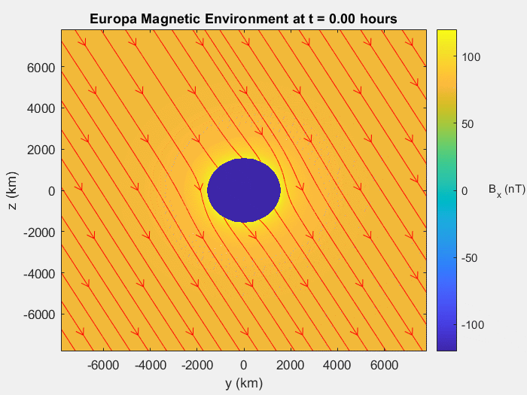
Simulation Setup
7/31/25
Using EphiO coordinate system (x = direction of Europa orbit, y = towards Jupiter, z completes system) here
Jupiter field is constant on z, oscillates on x and y. Europa field modelled as an induced dipole, and total field is the sum
Passing plasma makes E-field, modelled by E = -v_{plasma} x B

Slide 5
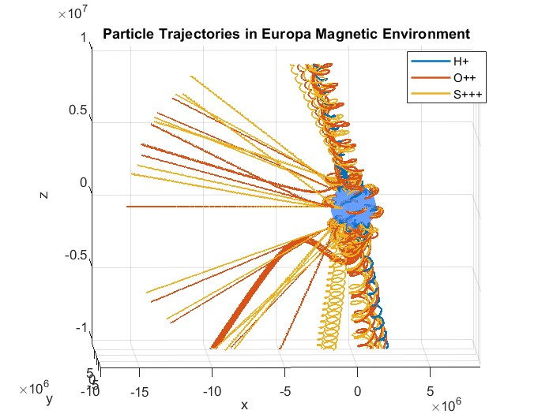
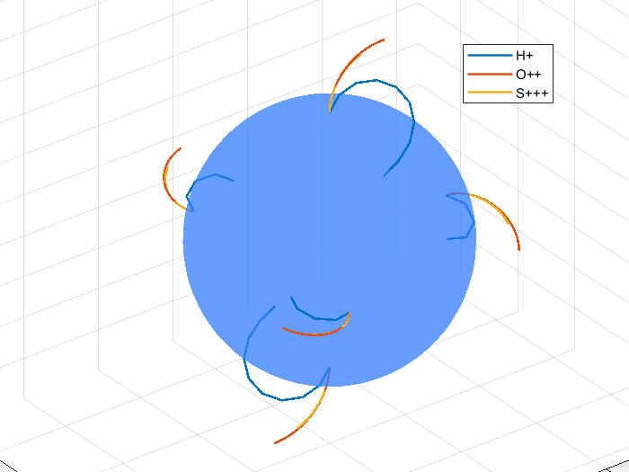
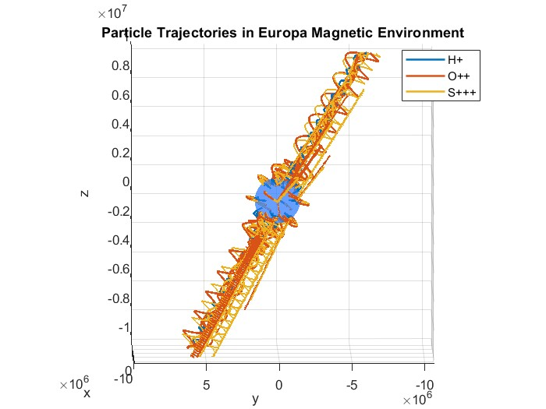
Particle Tracing
7/31/25
In backwards tracing, particles are started at impact and traced back in time
Only ionized particles affected by E&M forces! Modelling ionized Hydrogen, Oxygen, and Sulfur
Often modelling thousands of particles at once! Need to neatly track their positions, velocities, and energies for analysis!

Slide 6
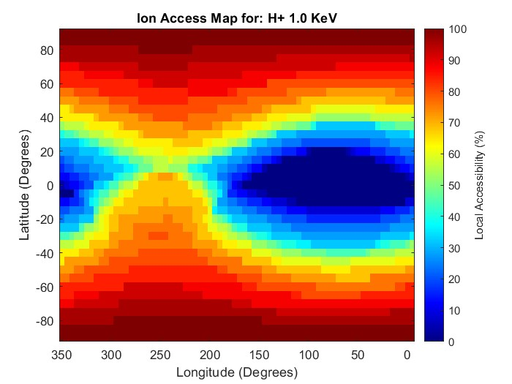
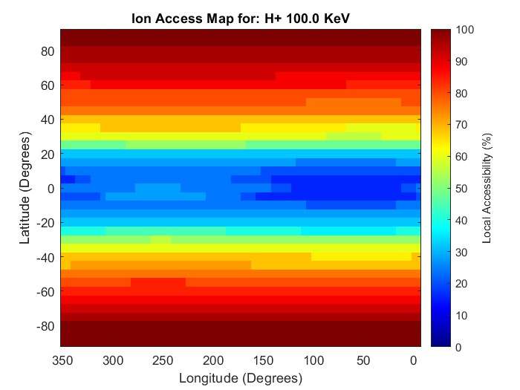
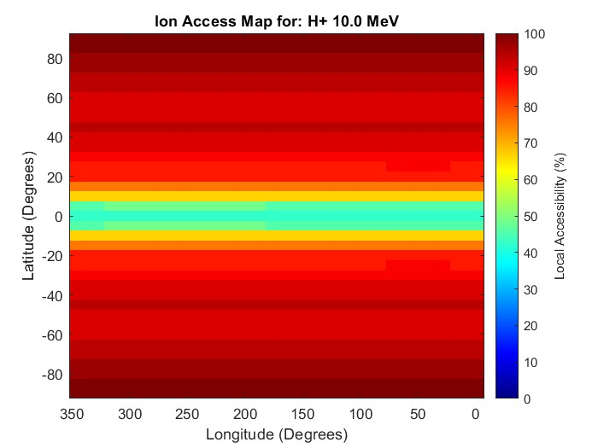
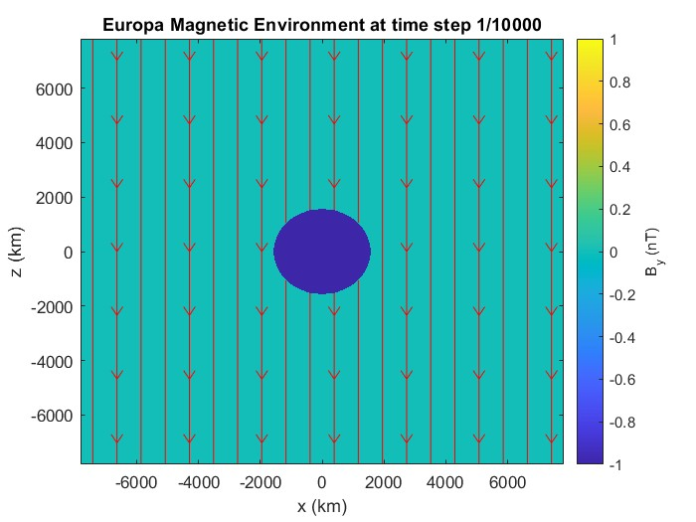
Results: Case 0
7/31/25
Testing Simple Case first: Jupiter field uniform in -z direction, NO induced field!
Access rates of higher energy particles generally superior to middle of range and lower energy particles
For surface coordinates, 0° faces Jupiter, 90° is Europa orbital direction, 270° faces plasma flow
Trailing Hemisphere (Flow Facing)
Leading Hemisphere

Slide 7
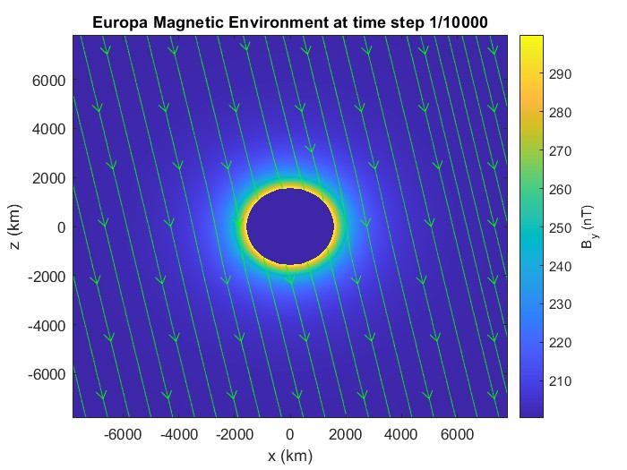
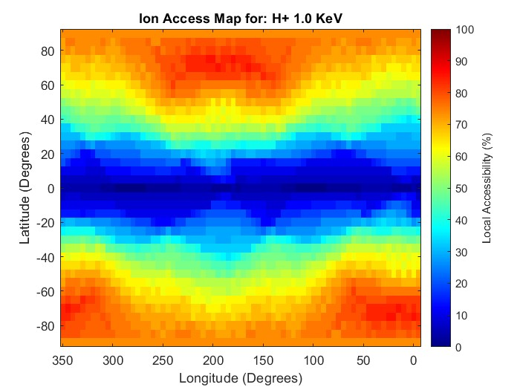
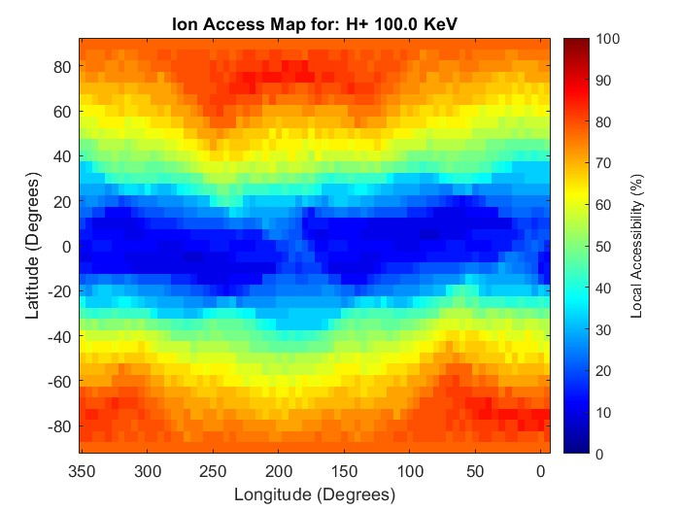
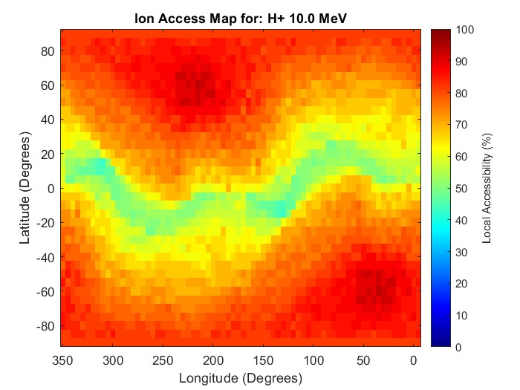
Results: Case 1
7/31/25
Introducing varying x/y components to Jupiter field, Europa Induced Field too!
NOT using E field here
Lower energy particles more spread between longitudes. Particles struggle to reach equator, or for higher energy particles, reach the “band”
O++ and S+++ behave rather similarly, but have generally high access rates
Modelled at beginning of synodic period

Slide 8
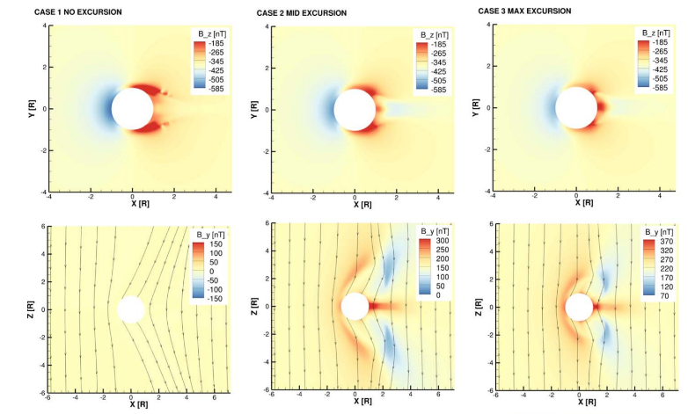
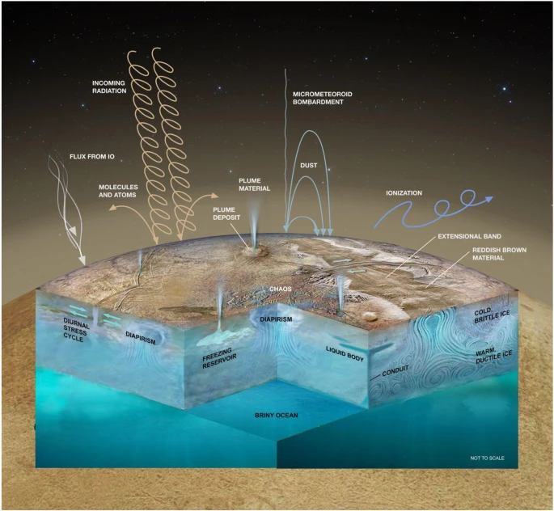
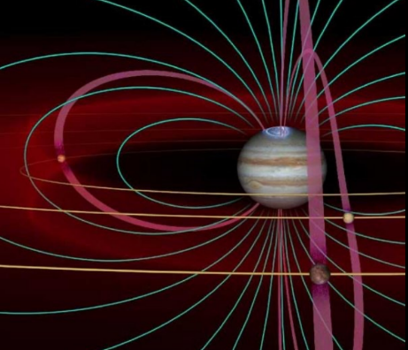
What Next?
7/31/25
Tracing dust particles?
Realistically modelling sources of particles (Jupiter system, Europa ionosphere, plumes, etc.)
Utilize MHD simulation results for B and E fields instead of analytically solving?
Courtesy of Nordheim et. al
Courtesy of Becker et. al
Courtesy of NASA/Boston University

Slide 9
Thank you!
7/31/25

